Slide 1
Keeping KP Affordable and Competitive
How unit-based teams are saving money for Kaiser Permanente
DATE 2025
Notes:
You know all about the challenges ahead of us when it comes to keeping KP affordable for the members and communities we serve. They are daunting! But the good news is, we have the tools to achieve our goals.
In 2021, KP and the Alliance of Health Care Unions pledged to work together to
explore factors impacting KP’s success
identify cost savings and efficiencies
and secure a successful long-term future for Kaiser Permanente, our workers, and patients
And there is even better news: We have a secret weapon that our competitors do not: Our Labor Management Partnership and unit-based teams.
Over the last 25 years, we’ve built a culture of listening to the voices of the frontline. The people at the frontline know best how our work is done, and they know where the opportunities are to increase efficiency and save money. And, thanks to rigorous training and constant communication, they have the knowledge and skills to improve performance.
We know this because they are already doing it:

Slide 2

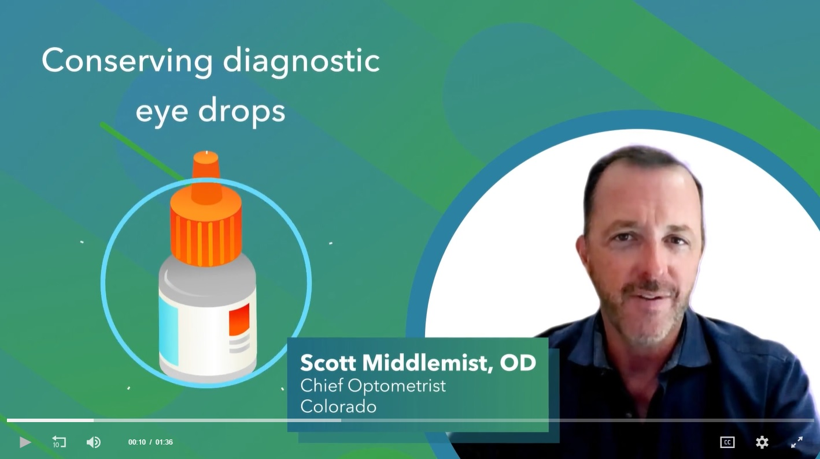
Optometry team saves $75,000 a year
VIDEO
This optometry team in Colorado found significant savings by using its supplies of diagnostic eye drops more efficiently. The team took advantage of changes to federal regulations that once required optometrists to throw away eye drops long before their expiration dates. With more time to use these eye drops – still perfectly safe – costs plummeted.
Cost savings: $75,000 annually
(Hover over video to play)
Notes:
An optometry team in Colorado saves significant sums by using diagnostic eye drops more efficiently.
[URL for this is https://www.lmpartnership.org/videos/colorado-optometry-team-sees-savings]

Slide 3
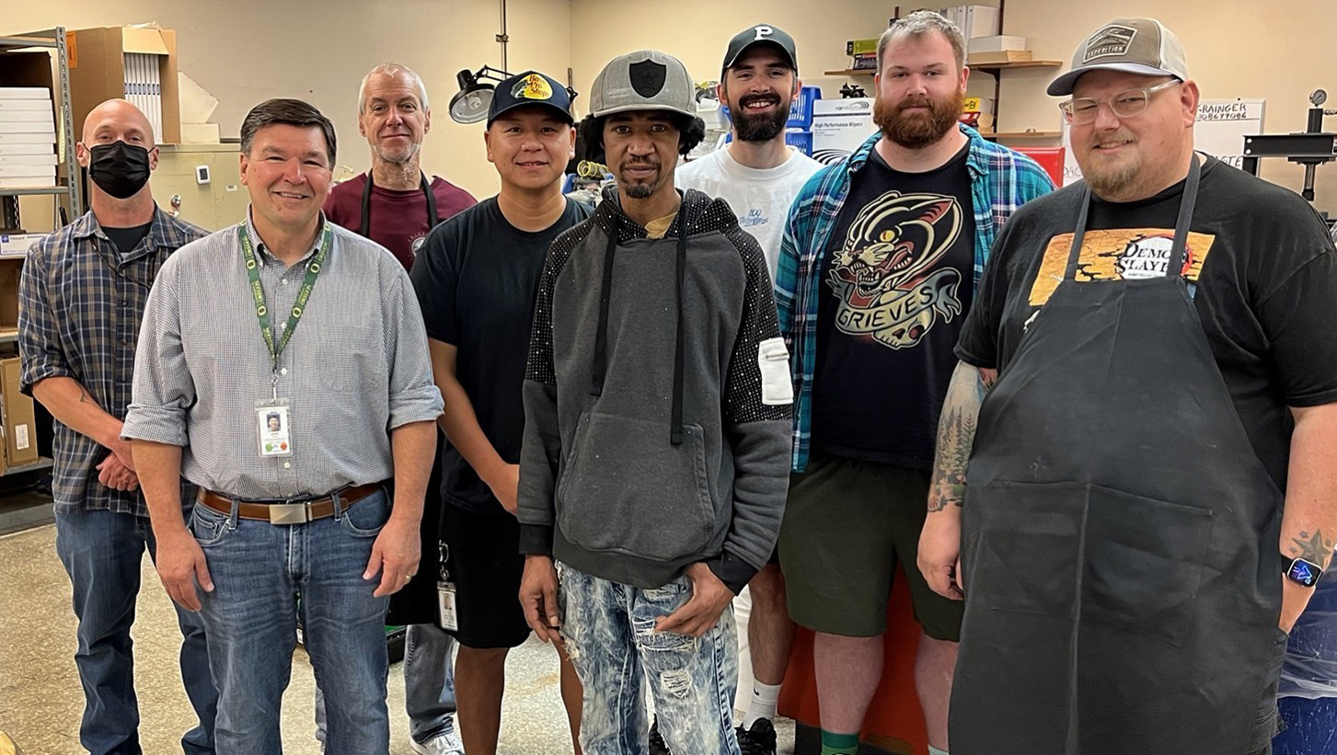
Optical Lab team saves $6,000 a year
A team of optical lab technicians in the Northwest faced an increase in scratched eyeglass lenses for Kaiser Permanente members. They discovered that wear
and tear on machinery was affecting
the lens-polishing process. By adjusting procedures and enhancing machine maintenance, they nearly eliminated
the scratches, improving service and reducing costs.
Cost savings: $6,000 annually.
Notes:
An optical lab team in the Northwest uncovered the cause of scratches to eyeglass lenses they prepare for KP members, saving $6,000 annually.
[URL for this is https://www.lmpartnership.org/team-tested-practices/technicians-turned-detectives-conquer-swirl-scratches]

Slide 4
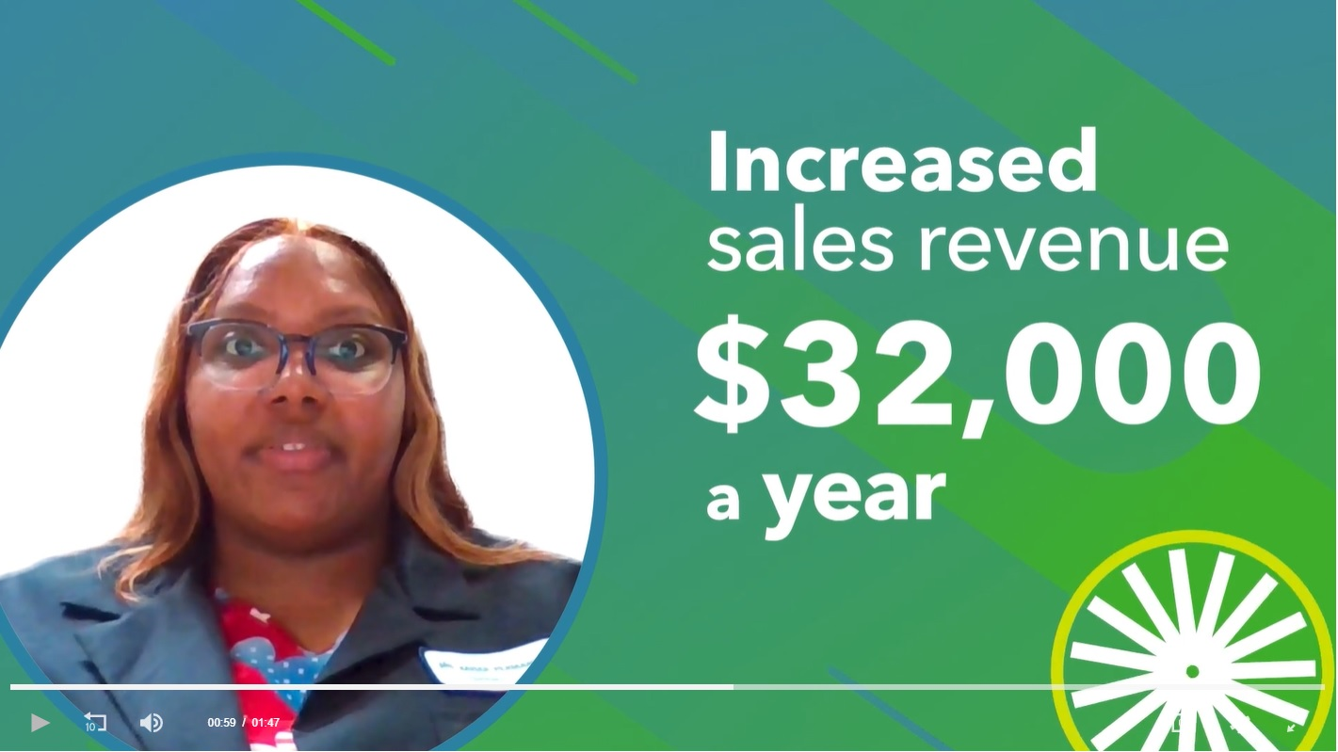
Pharmacy team improves sales by $32,000 a year
VIDEO
A Georgia pharmacy improved sales of over-the-counter products by listening to providers and patients. What they heard led them to adjust the products on pharmacy shelves to ensure the most in-demand items were available at the right time. The change helped the team exceed its goal of improving sales by 22 percent.
Additional revenue: $32,000 annually
(Hover over video to play)
Notes:
(A Georgia pharmacy increased sales of over-the-counter products by listening to providers and patients to ensure the most in-demand products were available.)
[URL for this is https://www.lmpartnership.org/videos/georgia-pharmacy-tackles-affordability]

Slide 5
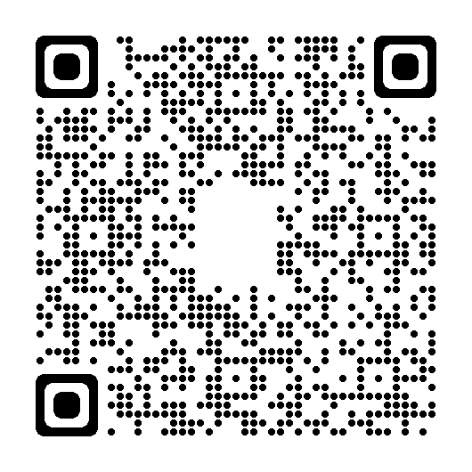
More Examples on LMPartnership.org
Scan this QR code with your smart phone camera to explore more UBT affordability projects on the Team-Tested Practices section of the LMP website.
Notes:
There are more examples of the ways UBTs have saved money on the LMP website. Browse through them on the Team-Tested Practices section by scanning this QR code.

Slide 6
More Examples in UBT Tracker
Log on to HRConnect
Navigate to Work @ KP
Labor & LMP
UBT Tracker
Search projects
Advanced search
In the Value Compass area, choose “Most Affordable”
Notes:
For even more examples, go to UBT Tracker.

Slide 7
TIPS AND TOOLS

Slide 8
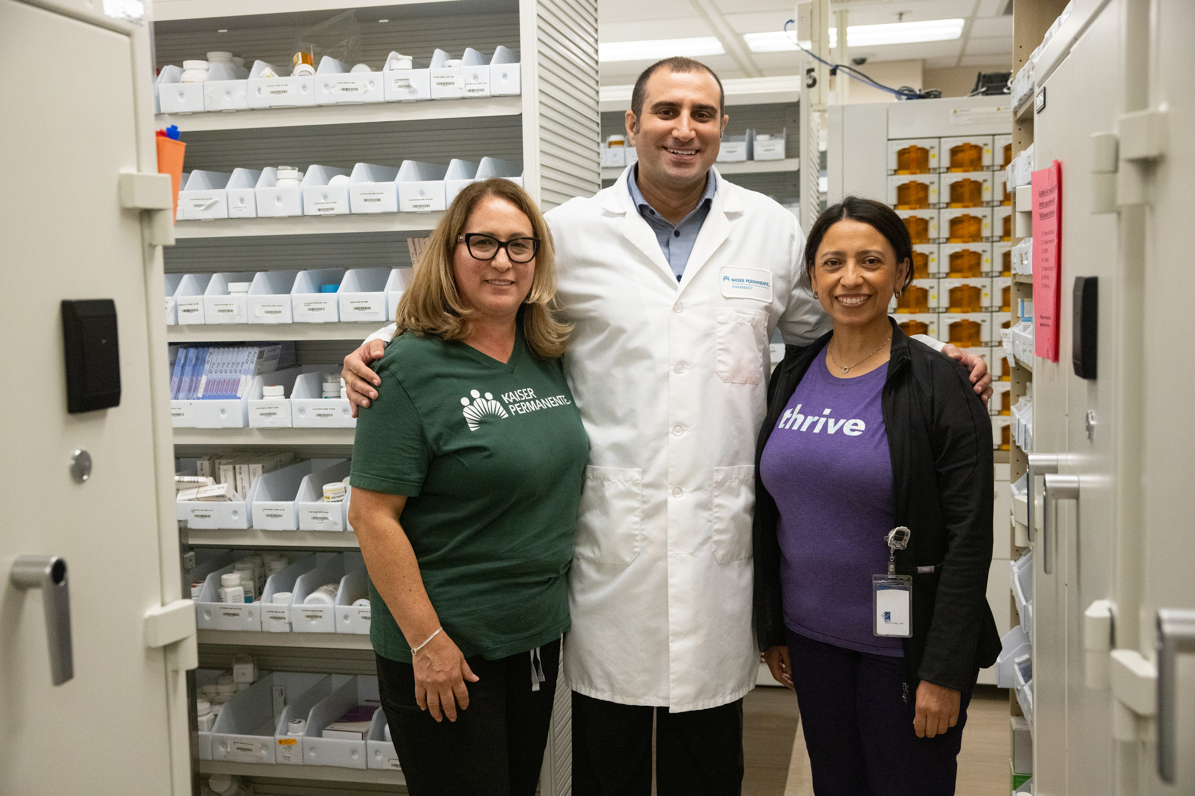
Tips for Reducing Supply Waste
Create an opportunity for everyone
in the department to give input about how often different supplies get used, so you don’t eliminate something the department needs.
Organize the supplies by figuring out where each item belongs and then labeling supplies and shelves. Also set “par” levels, figuring out the quantity the department should always have on hand.

Slide 9
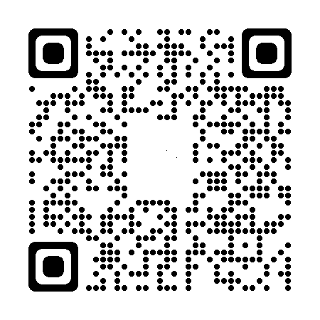
Tips for Reducing Supply Waste
Establish a signal for when supplies need to be re-ordered. And have a system for alerting people when an item is getting close to its expiration date.
Scan the QR code for more tips

Slide 10
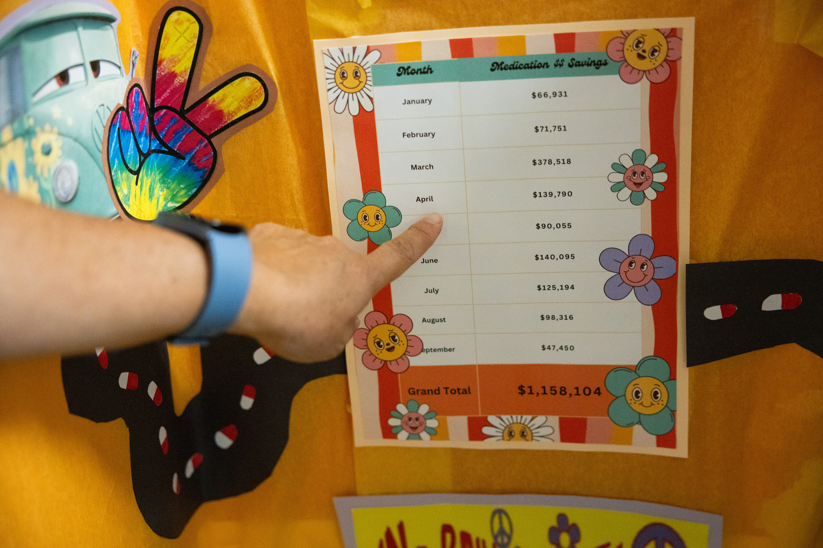
Tips for Tracking Financial Impact
Think about potential financial impact from the start of your project. This will help you identify early on the data to collect and monitor so the financial impact can be calculated later.
Understand your baseline metric. Once you know what your goal is, determine the associated costs before any changes are made. This will help you translate the improvement into money saved.

Slide 11
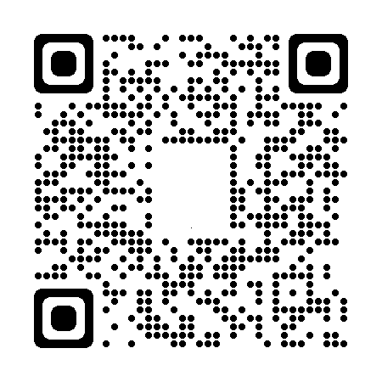
Tips for Tracking Financial Impact
Think about the cost associated with the staffing crisis. For instance, if your goal is to streamline scheduling, think about the potential costs, such as excessive overtime, associated with an inefficient schedule.
Scan the QR code for more tips

Slide 12
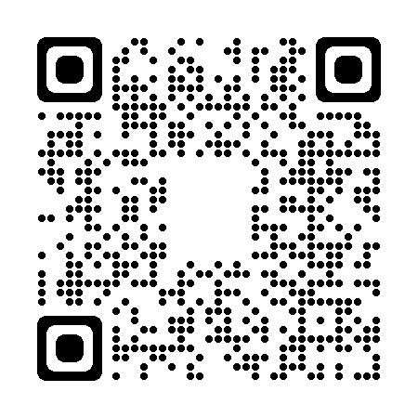
Download the Waste Walk How-to Guide
Scan the QR code to see
the How-to Guide
Notes:
Doing a waste walk is the best way to identify waste in a department. Our toolkit includes a video, step-by-step instructions and observation checklists.
[URL is https://www.lmpartnership.org/how-to-guide/do-waste-walk]

Slide 13
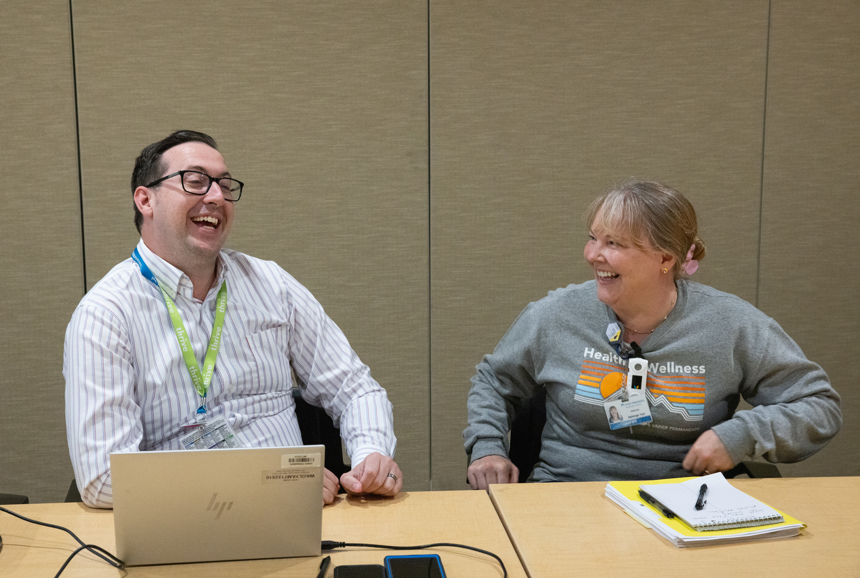
General Principles for UBT Affordability Projects
No matter the market or type of department, all successful affordability project share common principles.
Notes:
When we look at successful affordability projects, we start to see patterns emerge. No matter the market or type of department, there are a few general principles that pop up again and again.

Slide 14
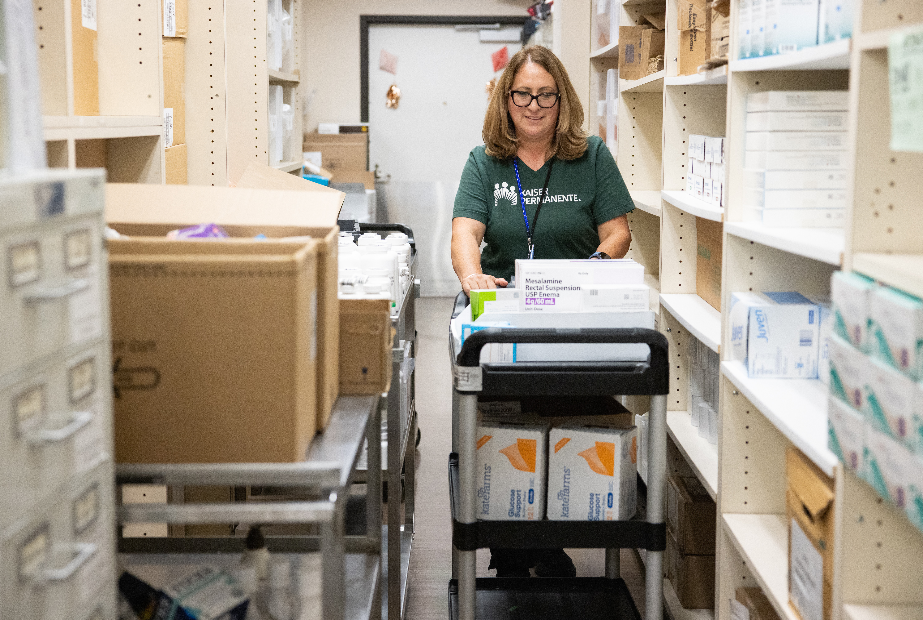
How might we reduce costs?
Standardize supply storage and ordering
Reduce demand for STAT orders
Reduce variation in supply ordering
Internalize testing and other services
Notes:
A phrase we use a lot in our Partnership work is, “how might we…?” It’s an invitation to brainstorm possibilities. We say that during bargaining and during performance improvement projects.
So, for our affordability work, we could start with, “how might we… reduce variation in supplies …”

Slide 15
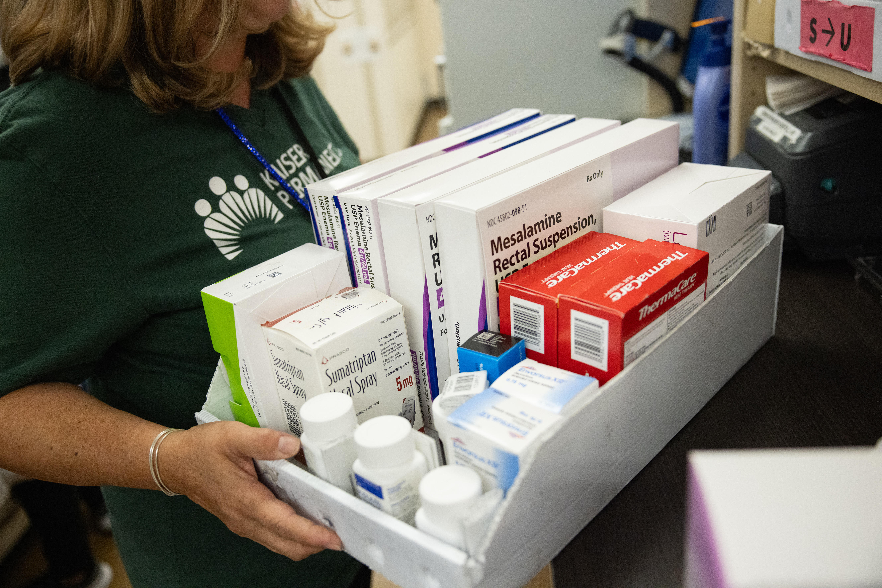
How might we increase efficiency?
Reduce re-work caused by incomplete information
Reduce error rate in processes
Use templates to reduce documentation time
Reduce readmissions

Slide 16
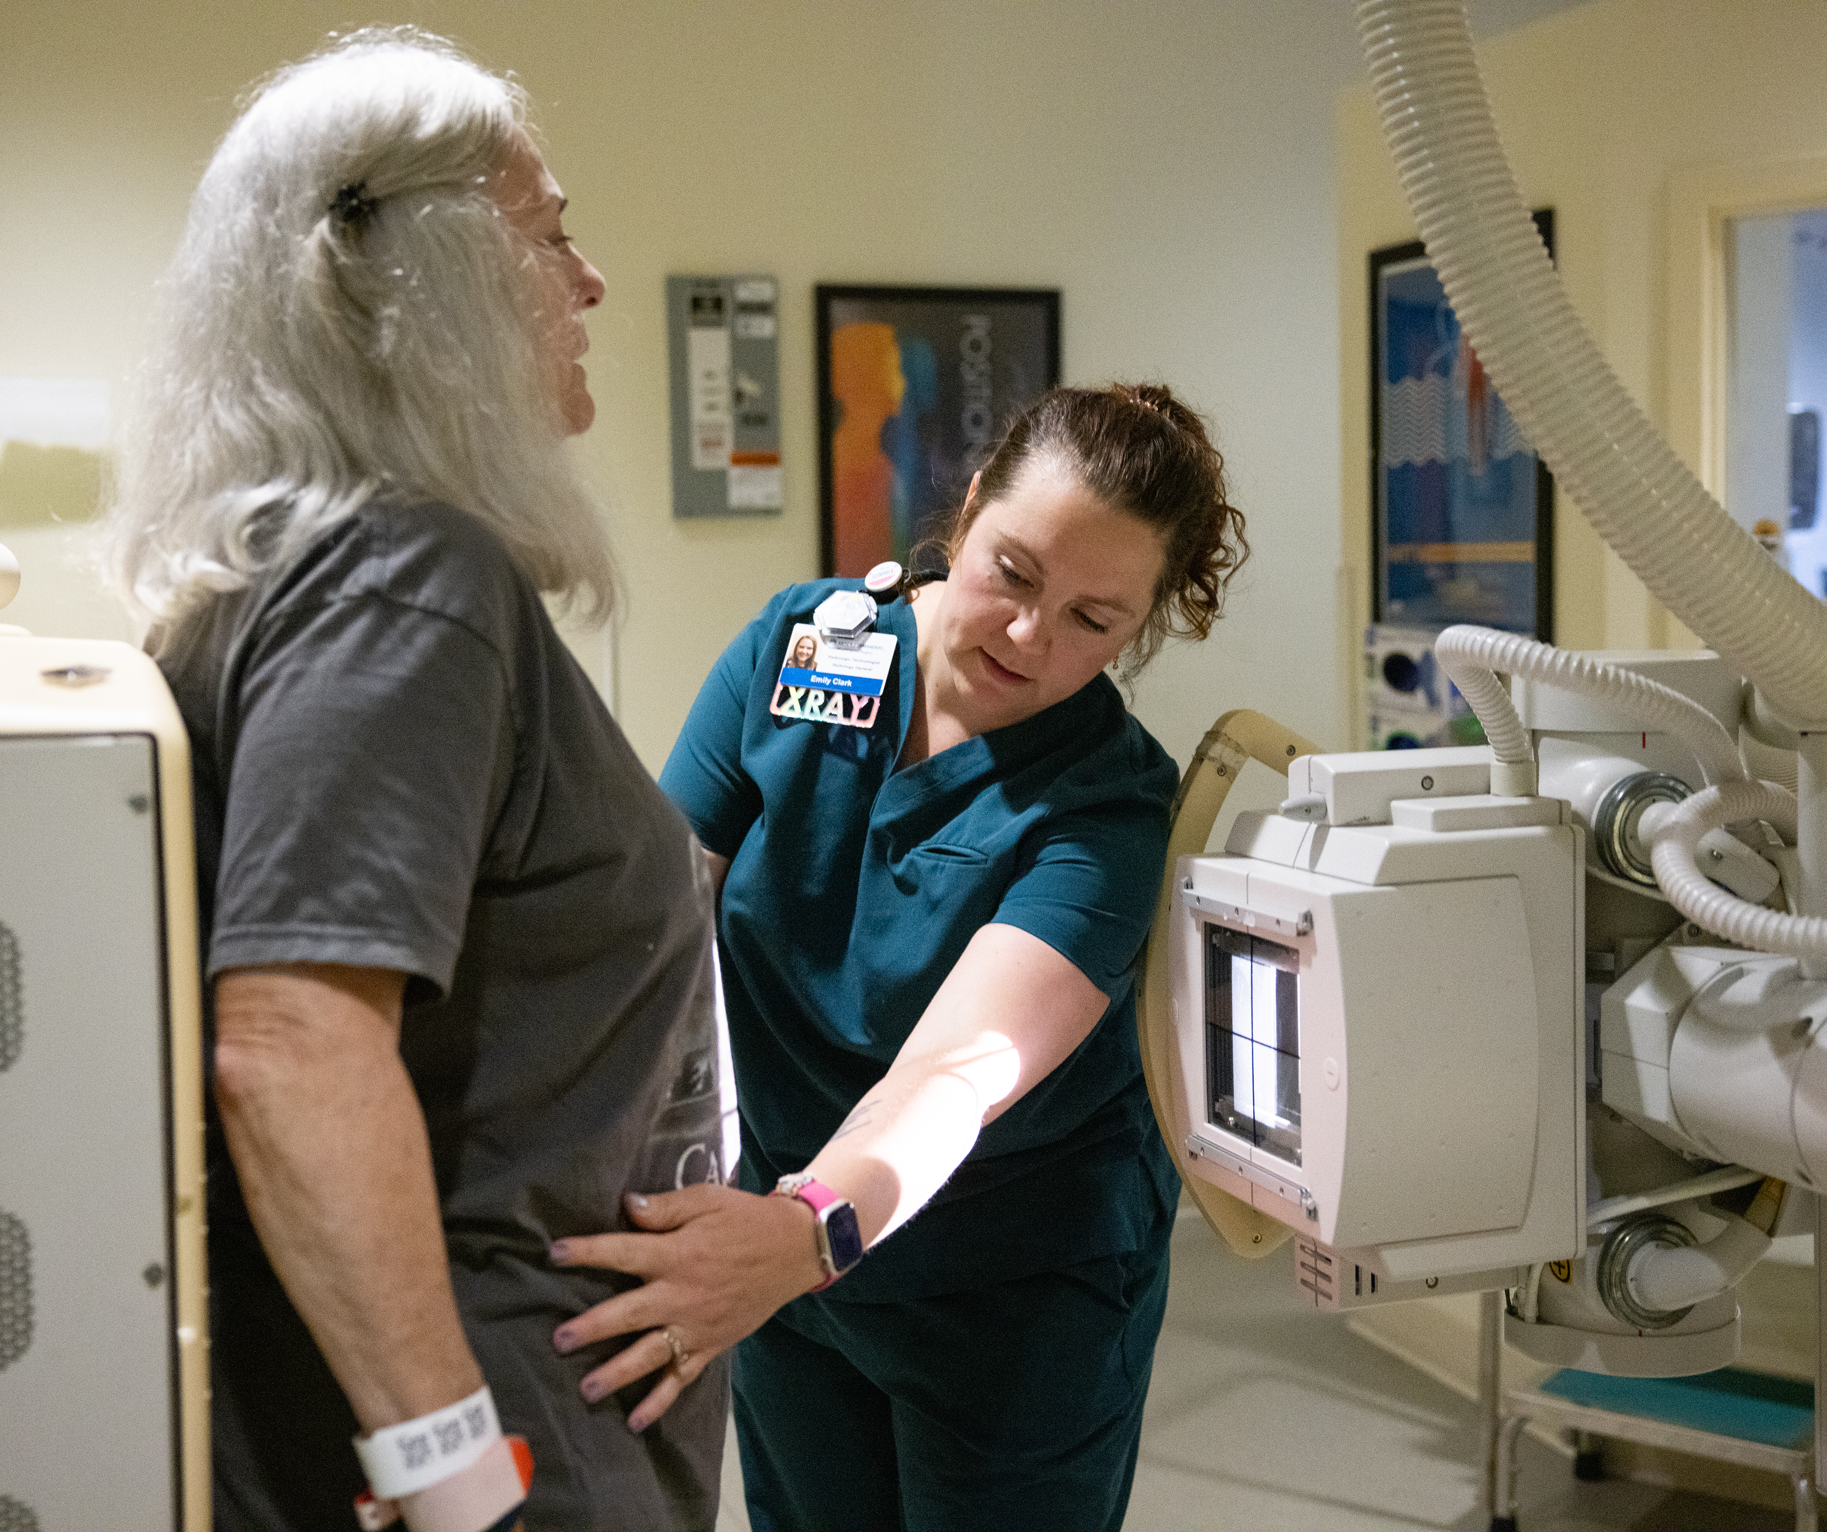
How might we improve hospital patient flow?
Ensure on-time surgical starts
Improve operating room turnaround times
Reduce transport delays
Integrate transport and lift teams

Slide 17
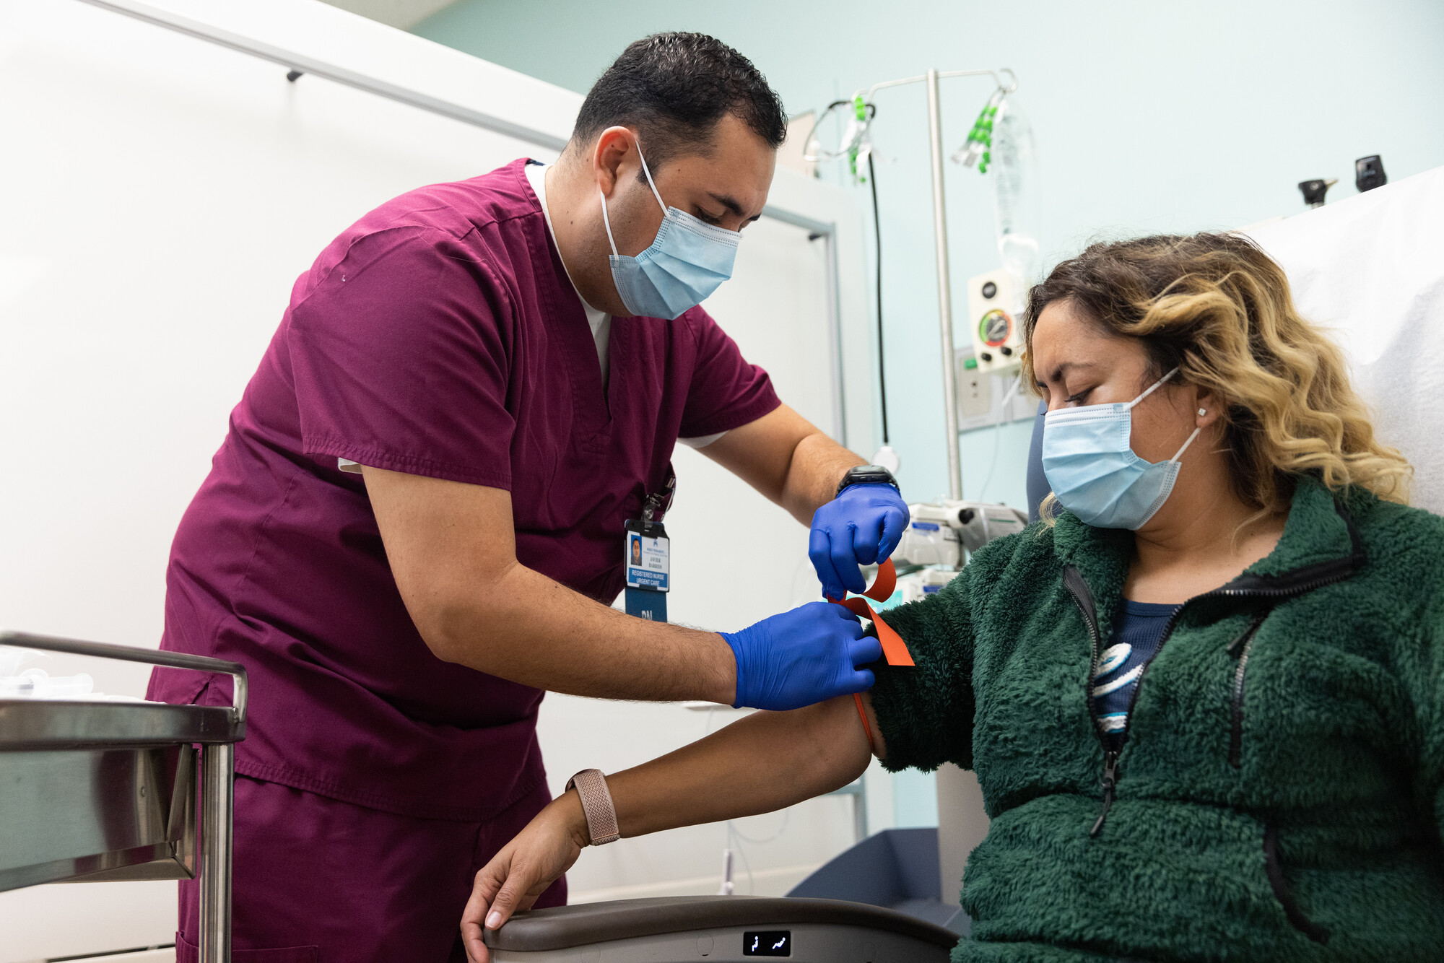
How might we improve outpatient flow?
Ensure clinic day starts on time
Decrease failure to keep appointments
Stagger start times for medical assistants to ensure physician support

Slide 18
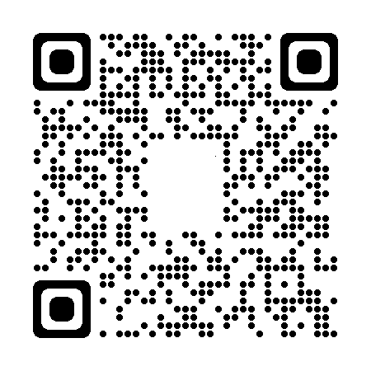

Multiply the Wins: Spread and Adopt
Scan the QR code for tips on spreading and adopting successful practices
Notes:
And what if UBTs that succeeded in saving money and increasing efficiency shared their experiences with other teams? What if UBTs adopted successful practices from one another? Then we could multiply the savings across facilities and markets.
Scan this QR code for tips and tools about how to spread and adopt successful practices. It requires a shift from “not invented here” to “proudly found elsewhere.”
https://www.lmpartnership.org/stories/steal-shamelessly

Slide 19

WE CAN DO IT!
Notes:
We have the tools. We have the people. We can do this!

