Slide 1
YOUR FUTURE AT KAISER PERMANENTE
JOBS OF THE FUTURE COMMITTEE
2018

Slide 2
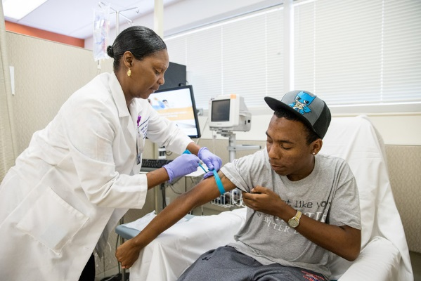
We’re changing how and where we deliver care
Patients expect a more personalized experience, based on when, where, and how they want to receive care. As a result, we’re making it easier for patients to access care whenever and however they choose.
Notes:
Our patients’ and members’ needs are evolving.
Patients expect a more personalized experience, based on when, where, and how they want to receive care.
As a result, we’re making it easier for patients to access care whenever and however they choose.
Examples include:
KP.org
KP mobile app
Tele-consult appointments
Target retail clinics
As we evolve where and how we deliver care via new patient care settings and virtual visits, the kind of care we provide is also expanding to include environmental and behavioral factors impacting health outside KP’s walls.

Slide 3
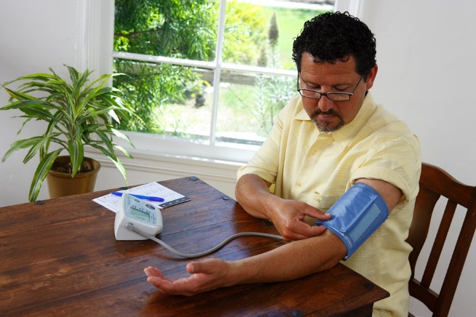
In response to our members’ needs, we are expanding access to care in person, online and by phone. Examples include kp.org, the KP mobile app, tele-consult appointments, and our retail clinics. The kind of care we provide is also expanding to include environmental and behavioral factors impacting health outside KP’s walls.

Slide 4
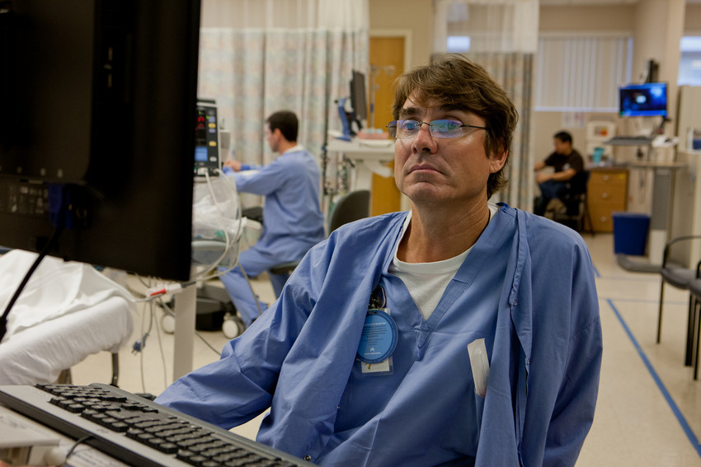
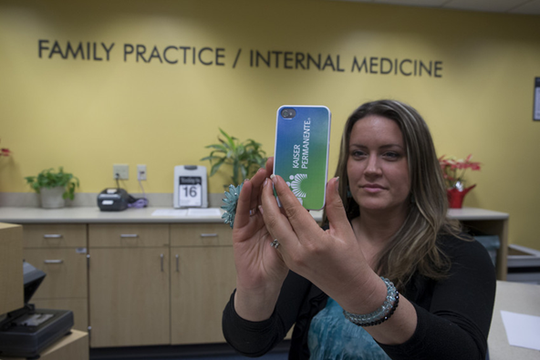
Jobs of the Future Committee
The Southern California Jobs of the Future Committee brings together labor and management to better align staffing with KP’s evolving care delivery channels.
The committee has created new roles and expanded others, enabling operations to better serve our members.
Notes:
In response to these changes, the Southern California Jobs of the Future Committee was formed to bring together labor and management to better align staffing with KP’s needs.
As a result, we have created new roles and expanded others.
Let me share some examples with you.

Slide 5
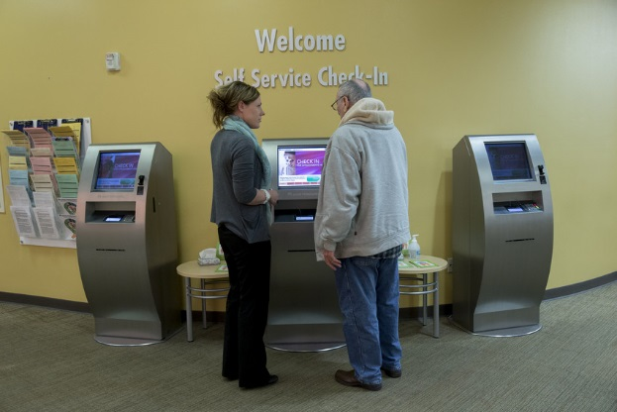
Expanded Role: Service Representative
Here’s an example of an expanded role: Service Representative
The service representative is:
Tech-empowered
Customer-focused
A problem-solver
Able to help members find what they need
Notes:
Here’s an example of a role that has expanded.
The receptionist of the future is:
tech-empowered
customer-oriented, knows how to problem-solve and owns the space of service.
Discussion Question: Do you see this expanded role in our facility? Are there other roles that are evolving in our workplace?

Slide 6
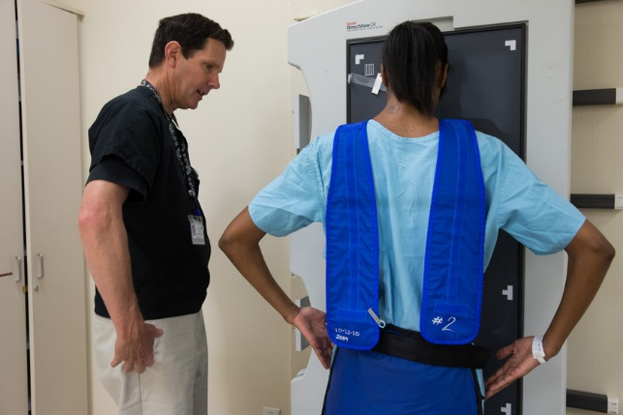
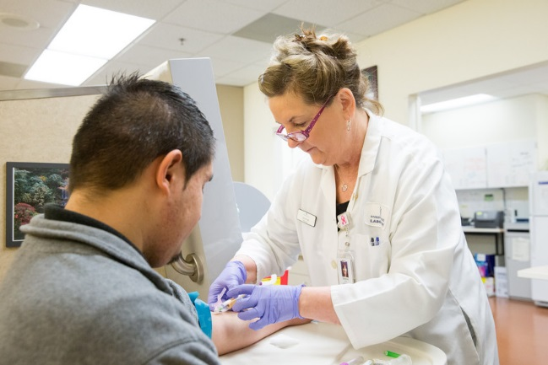
New Role: Multi-functional Health Care Worker
Here’s an example of a new role: Multi-functional Health Care Worker
This role is responsible for:
Core duties of MA or LVN
Back office support
Blood draw
Limited x-rays
Reception / navigation
This role requires a person who is:
Flexible
Able to adapt to changes in work flow and volume
Tech savvy
Team-player and collaborator
Notes:
The multi-functional health care worker is a new role that was created to provide care in our newest Medical Office Buildings.
These office buildings are based on a concept called Reimagining Ambulatory Design. It’s called “RAD” for short.
RAD facilities have unique features. They are:
designed to support complex and more involved outpatient care
have small, flexible spaces
use increased technology
support the use of tele-consult visits
The resulting workforce impact called for the creation of a Multi-functional Health Care Worker.
The Multifunctional health care worker:
Performs the core duties of an MA or LVN with additional duties:.
They provide back office support
do blood draws
Perform limited x-rays
serve as receptionists
This role requires someone who is:
cross-trained and flexible
Able to adapt to changes in work flow and volume
Tech savvy
Team-player and collaborator

Slide 7
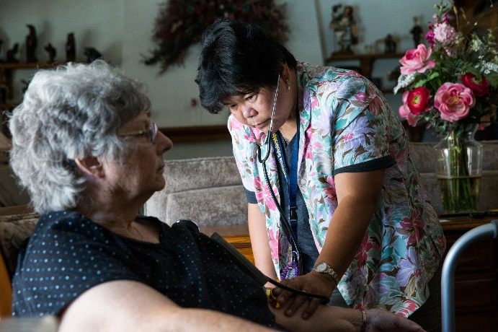
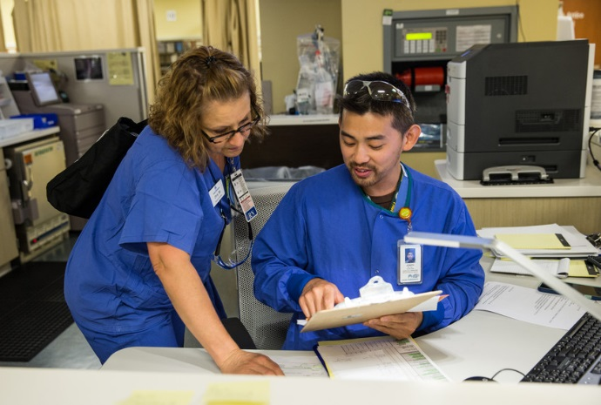
Emerging Roles
Emerging roles are taking shape in the fields of:
Nursing
Home care
Community health
Behavioral health
IT

Slide 8
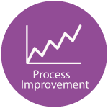
The Critical Skills
Regardless of your job, all roles require these critical skills in the 21st century.
Let’s review each.
Notes:
These new and expanded roles are different but they require the same Critical Skills.
National Workforce Planning and Development identified these Critical Skills as the foundation for all future KP employees. They are:
Consumer Focus
Digital Fluency
Collaboration
Process Improvement
You can find more information about the Critical Skills online at kpcareerplanning.org. Eligible employees can take free self-paced courses!

Slide 9
The Critical Skills – Collaboration
The future workforce will require more collaboration between team members. By understanding diverse perspectives and backgrounds, we can deliver quality care.
Find more information online at KPCareerPlanning.org
Notes:
These new and expanded roles are different but they require the same Critical Skills.
National Workforce Planning and Development identified these Critical Skills as the foundation for all future KP employees. They are:
Consumer Focus
Digital Fluency
Collaboration
Process Improvement
You can find more information about the Critical Skills online at kpcareerplanning.org. Eligible employees can take free self-paced courses!

Slide 10
The Critical Skills – Consumer Focus
Delivering excellent care requires employees to engage with members by listening, showing empathy, and communicating effectively.
Find more information online at KPCareerPlanning.org
Notes:
These new and expanded roles are different but they require the same Critical Skills.
National Workforce Planning and Development identified these Critical Skills as the foundation for all future KP employees. They are:
Consumer Focus
Digital Fluency
Collaboration
Process Improvement
You can find more information about the Critical Skills online at kpcareerplanning.org. Eligible employees can take free self-paced courses!

Slide 11
The Critical Skills – Digital Fluency
Access anywhere for members requires technical innovation. Adapting to new technology in the workplace is a critical skill that everyone needs.
Find more information online at KPCareerPlanning.org
Notes:
These new and expanded roles are different but they require the same Critical Skills.
National Workforce Planning and Development identified these Critical Skills as the foundation for all future KP employees. They are:
Consumer Focus
Digital Fluency
Collaboration
Process Improvement
You can find more information about the Critical Skills online at kpcareerplanning.org. Eligible employees can take free self-paced courses!

Slide 12
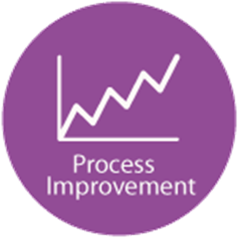
The Critical Skills – Process Improvement
Critical thinking skills to evaluate and implement new business concepts
and a proactive mindset is essential for everyone.
Find more information online at KPCareerPlanning.org
Notes:
These new and expanded roles are different but they require the same Critical Skills.
National Workforce Planning and Development identified these Critical Skills as the foundation for all future KP employees. They are:
Consumer Focus
Digital Fluency
Collaboration
Process Improvement
You can find more information about the Critical Skills online at kpcareerplanning.org. Eligible employees can take free self-paced courses!

Slide 13
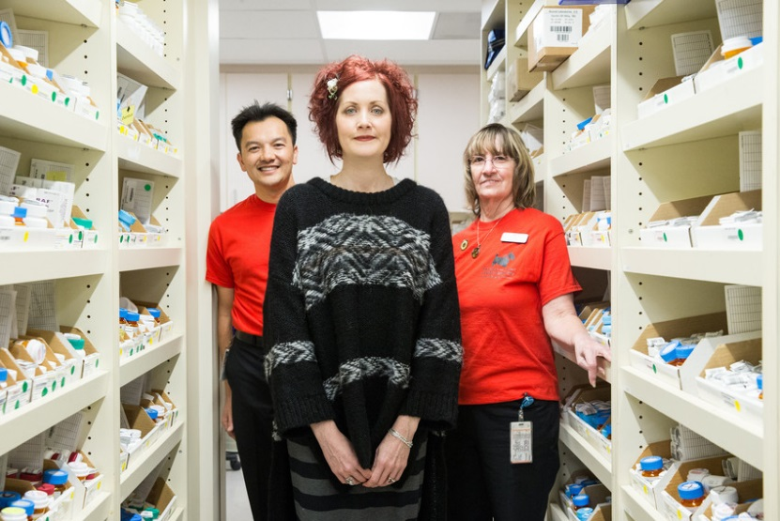
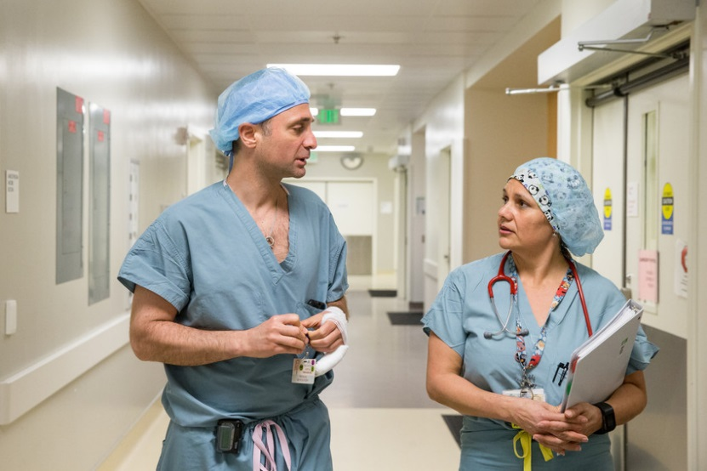
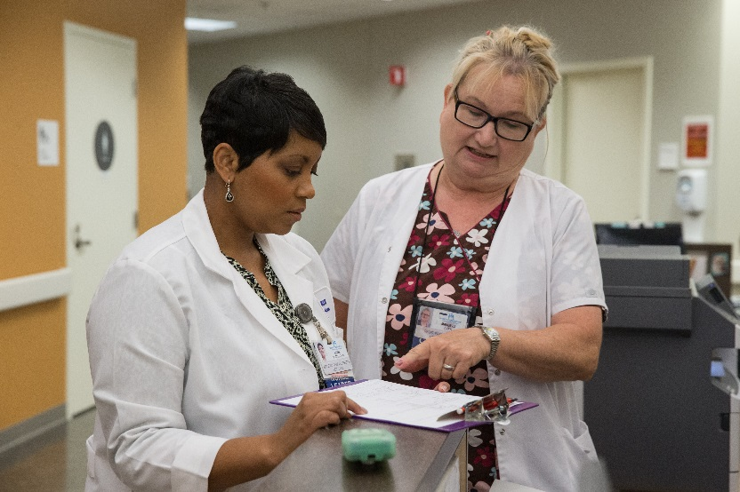
Career Resilience
Learning these critical skills will help us to effectively adapt to changes in our workplace.
That’s called career resilience.
Notes:
Learning these Critical Skills will give us the tools we need to effectively meet changes in our workplace. That’s called career resiliency. It’s important to build up our career resiliency “muscles” because:
Kaiser Permanente is constantly innovating.
Healthcare is constantly changing.
Technology is constantly being updated.
We need to constantly be developing, too.

Slide 14
Discussion Questions
What changes are happening in our department?
How is our team applying the Critical Skills in response to the changes we’re seeing?
How can we collaborate so that everyone has time to learn the Critical Skills?
Notes:
Now’s let’s talk about the changes we’re seeing in our workplace.
(Ask audience to respond to questions on the slide. Flipchart responses, create action items, and follow up with the team during a staff huddle or meeting).

Slide 15
Resources
Career Planning website – http://www.kpcareerplanning.org/prd/index.php
KP Strategy – http://insidekp.kp.org/insidekp/strategy
Ben Hudnall Memorial Trust – www.BHMT.org
SEIU-UHW West & Joint Employer Education Fund – https://www.seiu-uhweduc.org/
Industry Competency Models –http://www.careeronestop.org/CompetencyModel/ETA_industry_competency_initiative.aspx
Conference Board Employability Skills –
http://www.conferenceboard.ca/topics/education/learning-tools/employability-skills.aspx
Institute for the Future – http://www.iftf.org/futureworkskills/
Institute of Medicine – https://iom.nationalacademies.org/Reports/2010/The-Future-of-Nursing-Leading-Change-Advancing-Health.aspx

