Slide 1
LMP Methods booster
Interest-based problem solving and consensus decision making
May 2021

Slide 3
Your Facilitators

Slide 4
IBPS CDM Reflective Questions
Chat Activity
Notes:
Facilitator notes:
After participants watch the video, facilitate a group discussion posing up to 3 of the following refection questions. When selecting reflection questions, consider any polling questions that you’ve chosen to avoid redundant discussions.

Slide 5
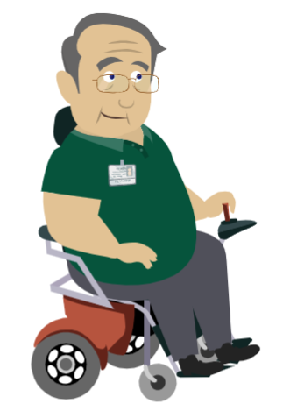
Chat Activity:
What are the steps of Interest Based Problem Solving (IBPS)?
Notes:
Facilitator notes:
The steps are as follows:
Define the problem.
Determine interests.
Develop options.
Select a solution.

Slide 6
Chat Activity
Why do you think IBPS is important and why do you think we use it here at KP?
Notes:
Facilitator notes:
Possible responses may include the following:
Focus on everyone’s key interests and everyone’s contribution is valued.
IBPS enhances our communications.
IBPS helps maintain productive and respectful working relationships.

Slide 7
Chat Activity
Why are the 2 methods, IBPS (interest-based problem solving) and CDM (consensus decision making), paired together?
Notes:
Facilitator notes:
Possible responses may include the following:
IBPS requires consensus to be reached at each step.
Focusing on interests and concerns (versus positions) helps reach consensus on the issue or problem.
When problem solving, CDM encourages that everyone’s voice is heard.

Slide 8
Chat Activity
Although the IBPS (interest-based problem solving) steps have a specific order, in what circumstances might you revisit one or more steps of IBPS?
Notes:
Facilitator notes:
Possible responses may include the following:
When you want to refine a particular step, it is perfectly normal to revisit and go back to a previous step.
This can occur as new information is discovered or when something was not defined completely or accurately in a previous step.
If the group appears to be getting stuck in a particular step, it can also be beneficial to recognize the situation and give yourself permission to move to the next step with the understanding that you will revisit the previous step, if necessary.

Slide 9
Chat Activity
For IBPS (interest-based problem solving) and CDM (consensus decision making) to be successful, what type of mindset do you need to have?
Notes:
Facilitator notes:
Possible responses may include the following:
A “partnership” mindset is required to solve the problem in consensus, taking into account common interests.
Have an attitude of “your problem is my problem, and my problem is your problem.”

Slide 10
Chat Activity
Why is it important to confirm consensus by asking the 3 questions?
Notes:
Facilitator notes:
Possible responses may include the following:
It allows for the inclusion of a wide variety of voices and perspectives.
It helps ensure that standout concerns have been resolved or addressed in the final solution.
The question “Can everyone live with the decision?” acknowledges that the solution might not be your first choice and confirms that it’s one you can live with.
The question “Will everyone actively support the decision?” helps confirm that all parties will support the solution outside of the room and ensures successful implementation of that solution.

Slide 11
Chat Activity
What are some of the benefits of using IBPS (interest-based problem solving) and CDM (consensus decision making)?
Notes:
Facilitator notes:
Possible responses may include the following:
More creative thinking and problem-solving
Better solutions
Faster implementation
Increased engagement because everyone is helping to find a solution
Increased team commitment
Better relationships

Slide 12
Chat Activity
What types of behaviors do you think support IBPS (interest-based problem solving and CDM (consensus decision making)?
Notes:
Facilitator notes:
Possible responses may include the following:
Listening actively
Focusing on key interests
Being prepared to offer potential solutions or options
Being open to new ideas
Ensuring everyone is heard
Showing respect to others

Slide 13
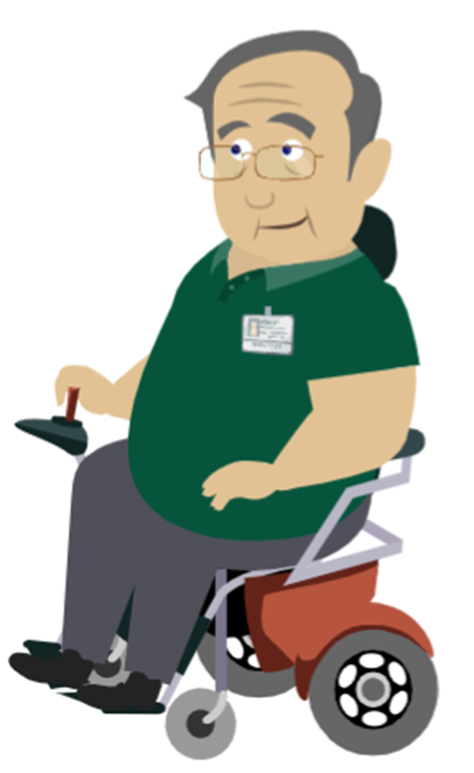
Chat Activity
What does it look like when someone is actively supporting a decision outside of the meeting?
Notes:
Facilitator notes:
Possible responses may include the following:
The person is actively working on completing assigned action items.
The person proactively communicates and uses agreed upon talking points outside of the meeting.
When asked, the person speaks highly of the decisions agreed to in the meeting.

Slide 14
IBPS Breakout Activity
Learner instructions:
Using the problem statement provided by your facilitator, work through the remaining steps in the IBPS (interest-based problem solving) process.
Review the tips and ensure each step is completed before going to the next step.
Be prepared to discuss your responses.
You have 20 minutes to complete this breakout activity.
Notes:
Facilitator notes:
Group your participants (groups of 4-6 people are ideal).
Provide your participants with the Learner Worksheet.
Review the worksheet with the learners and assign your participants one of the following problem-solving statements:
How might we decide a location for our vacation?
How might we educate employees on new equipment?
Ask them to work through the IBPS process using the framework in the Learner Worksheet. Allow 20 minutes for this activity.
Debrief and review the scenario using the answer sheets for the associated problem-solving statement on the following pages.

Slide 15
CDM Breakout Activity
Learner instructions:
In your group, brainstorm and write down a list of potential answers to the assigned discussion question.
Individually identify and rank your top three choices and be prepared to explain your choices if asked.
As a group, choose and rank the group’s top 3 choices and check for consensus.
Be prepared to share your group’s top three choices.
You have 10 minutes to complete this breakout activity.
Notes:
Facilitator notes:
Group your participants (4 to 6 people per group is ideal) and assign each group one of the following two questions:
What song best represents the year 2020?
If given $5,000, what 3 things would your team most like to purchase?
Review the instructions with the groups and give them 10 minutes to complete the activity.
Reconvene and have each group share their top three choices.

Slide 16
Resources
Notes:
Facilitator notes:

Slide 17
Resources
Job aids
Consensus Decision Making and Interest-Based Problem Solving
Courses
Interest-Based Problem Solving
Consensus Decision Making

Slide 18
Thank you for joining us.​ ​ If you have any questions, please contact: ​ <fill in appropriate name and email address>​

Slide 19
Appendix
Polling Questions
Notes:
Facilitator notes:
After watching the video, ask questions to increase and check for retention in a fun way. Use your preferred polling tool and any 3 of the following questions to create an interactive poll. When selecting polling questions, consider any reflection questions that you’ve chosen to avoid redundant discussions.
Note: This activity requires advanced preparation based on the polling tool which you will be using. Answers are in bold font.

Slide 20
Poll Question
What does IBPS stand for?
Interest-based problem solving
Intuition-based process solutioning
International bargaining problem solving
Interest bargaining process steps
Notes:
Answer is a)
Interest-based problem solving
Intuition-based process solutioning
International bargaining problem solving
Interest bargaining process steps

Slide 21
Poll Question
What are the steps of IBPS in the correct order?
Determine interests > Define the problem > Develop options > Select a solution
Define the problem > Develop options > Determine interests > Select a solution
Define the problem > Determine interests > Develop options > Select a solution
Define the problem > Develop options > Select a Solution
Notes:
Answer is c
Determine interests > Define the problem > Develop options > Select a solution
Define the problem > Develop options > Determine interests > Select a solution
Define the problem > Determine interests > Develop options > Select a solution
Define the problem > Develop options > Select a Solution

Slide 22
Poll Question
Which of the following statements are true? (Select all that apply)
IBPS starts with a solution the majority votes on.
In IBPS, everyone’s contribution is valued.
In IBPS, multiple solutions and creativity are encouraged.
IBPS is often paired with consensus decision making.
Notes:
Answer is b, c, and d
IBPS starts with a solution the majority votes on.
In IBPS, everyone’s contribution is valued.
In IBPS, multiple solutions and creativity are encouraged.
IBPS is often paired with consensus decision making.

Slide 23
Poll Question
In consensus decision-making, everyone must agree on the best answer.
True
False
Notes:
Answer is False

Slide 24
Poll Question
Consensus decision-making is used during the IBPS process.
True
False
Notes:
Answer is True

Slide 25
Poll Question
Choose the 3 questions that check for consensus.
Will everyone actively support the decision?
Has everyone in your group been heard?
Is there a majority that agrees with this?
Can everyone live with the decision?
Is there another solution we need to consider?
Was discussion encouraged?
Notes:
Answer is a, b, and d
Will everyone actively support the decision?
Has everyone in your group been heard?
Is there a majority that agrees with this?
Can everyone live with the decision?
Is there another solution we need to consider?
Was discussion encouraged?

