Slide 1

Materials Management UBT
Panorama City – May 23, 2012
Notes:
Note to teams:
Font: Times New Roman, 20 to 28 point
Use any or all of the slides
Load presentation onto your laptop
Show on automatic loop or go through presentation manually with a specific audience

Slide 2
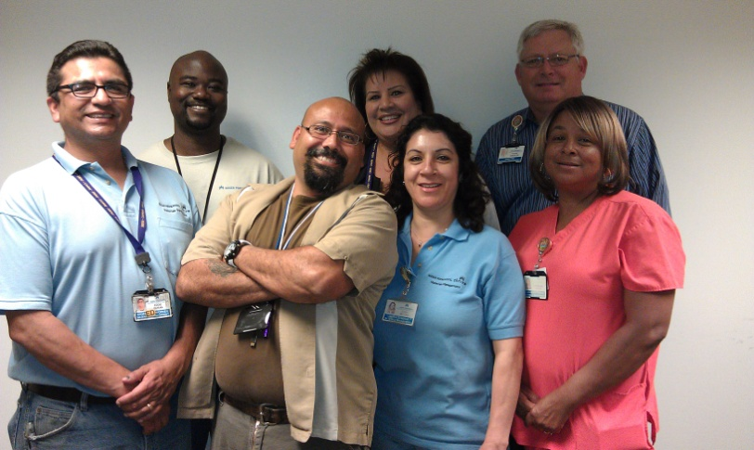
Our Team
Name | Title/Classification/Union
Byron Wilson | Data Entry Clerk/UHW
Eddie Duran | Storeroom Worker/UHW
Edwin Hernandez | Storeroom Worker/UHW
Lucia Medina | Linen Worker/UHW
Sandra Hernandez | Data Entry Clerk/Co-chair/UHW
Stephanie Perkins | Linen Lead/UHW
Steve Spickler | Director/Co-lead
Notes:
Name all team members or representative team members
Designate co-leads
To add names, right click anywhere in table, select insert row below

Slide 3

Our SMART Goal
KP SCAL Panorama City Materials Management Linen department will reduce the overall annual cost of linen (purchases & laundry) in Maternal Child Health by 2% (2% of $147,649 = $2,953) by September 2011.
Notes:
A SMART goal is Specific, Measureable, Attainable, Realistic, Time-bound.
Specific: Be clear about what you want to improve.
Define your scope of work.
Measureable: How will you track improvements? If you
don’t have baseline numbers, that first thing you need
to do is establish them. Be sure to record your baseline
and target numbers.
Attainable: What is your current performance? Do you
really think you can attain the goal in the time frame
stated? Be ambitious, but make the goal achievable.
Realistic/Relevant: Is this something the team can directly
affect? Does it have a bearing on the main work of the
department?
Time-bound: Be sure to include when the improvement
will be made by.

Slide 4
Our Best Practices
Linen stocking levels are established based on actual usage
Linen is used by departments in the appropriate manner (i.e. following the bed making policy, not using linen to mop up spills, reducing waste.)
Standardizing the products that are used
Scrubs are managed
Notes:
Discuss the example of stocking L&D rooms with linen at $0.31 per pound. Lost scrubs – ScrubEx saved about $50K in lost scrubs.

Slide 5
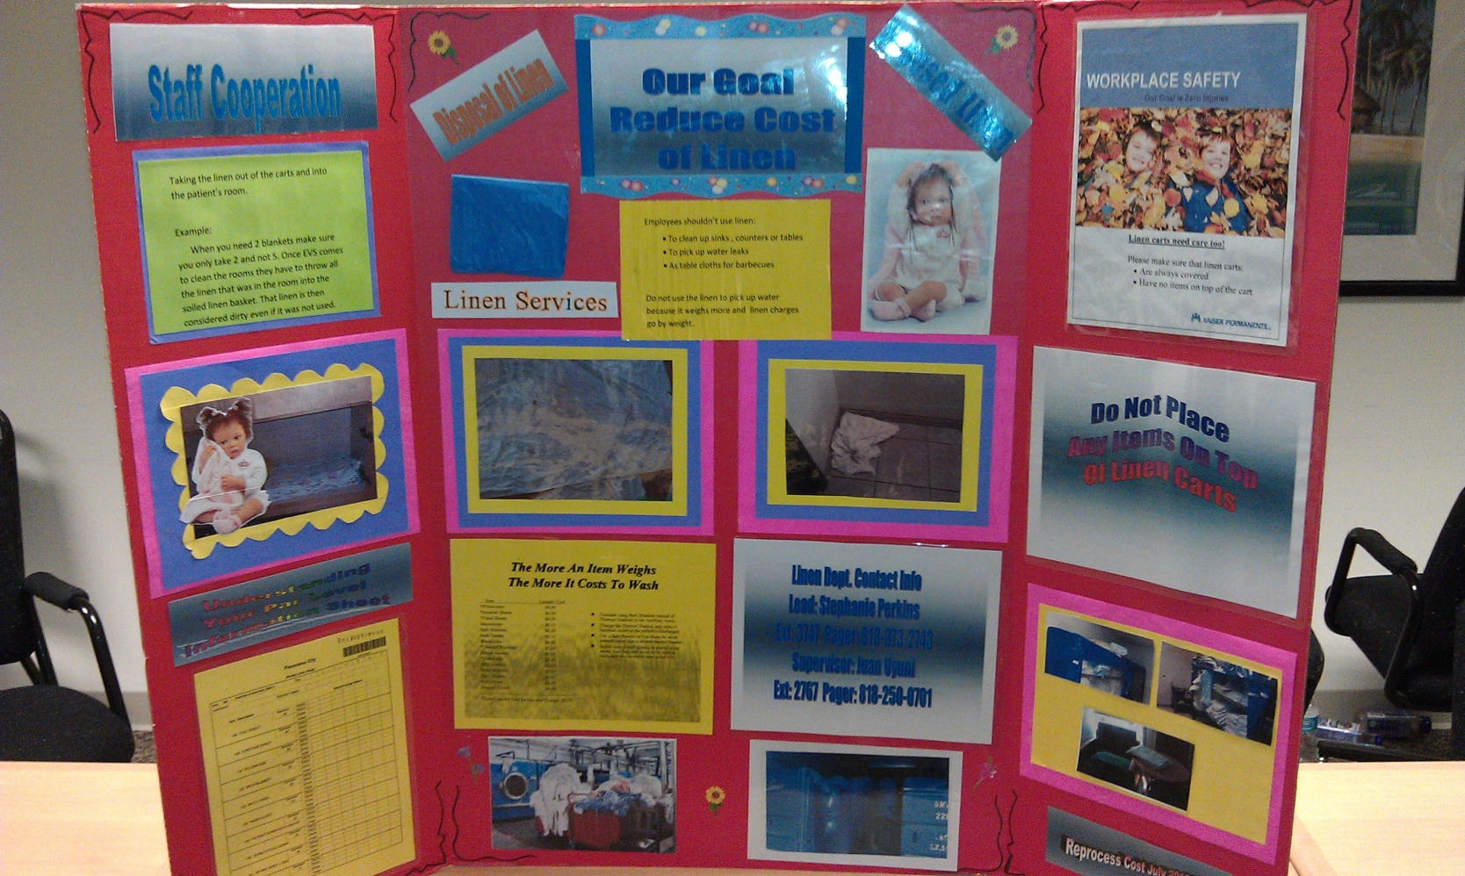
Telling Our Story
Notes:
Describe what’s on the story board

Slide 6
Our Small Tests of Change
Test of Change | Adopt Success | Adapt Adjustment | Abandon Did not work
Developed storyboards and met with UBTs | Very successful, lots of energy in the other UBTs
Reviewed linen usage and stocking levels with the departments | Departments were very receptive

Slide 7
Our Metrics
Measure | Data Source
Linen purchases and the charges for laundry services | Invoices, Purchasing history
Reviewed linen issues | In-house linen tracking system (Standard Textile)
Notes:
Insert data or chart

Slide 8
Our Challenges
Scheduling time to work on storyboards
Preparing staff to speak in front of another UBT groups
Notes:
What was done to prepare staff to speak. Used the story board as the agenda. Send a buddy.

Slide 9
Our Successes
The subject was eye-opening to the department staff
There was a lot of enthusiasm and brainstorming about how the unit could reduce its use of linen when the UBTs came together
Reduced MCH cost 6.8% ($9,990 - 2010 versus 2011)
Customer satisfaction scores went from 48% in 2010 to 65% in 2011 as measured by the Regional survey

Slide 10
Our Key Learnings
Preparation is the key to success when meeting with the other departments
  The storyboards were a big hit and they help the presenters stay on task and helped build confidence.
  Builds teamwork and confidence among the UBT members—taking a risk.
  UBT made the connection between their contribution and the financial success of the organization.
Intend to carry the project to the other departments
Notes:
Stress the value of data.

Slide 11
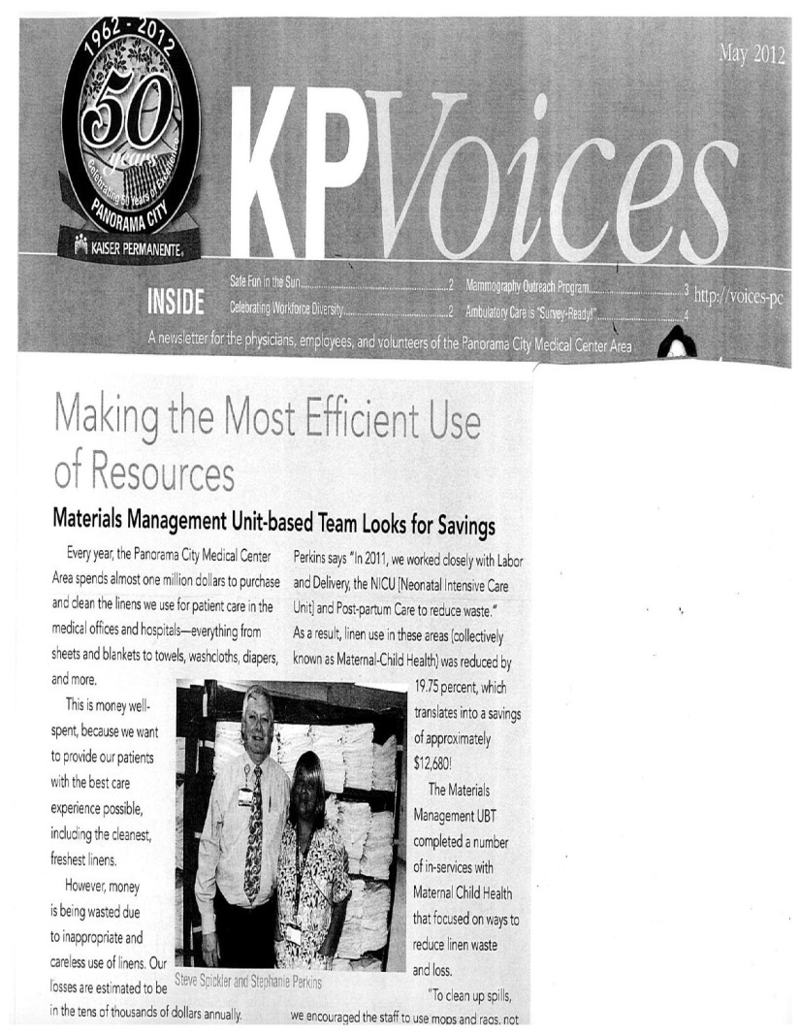
Our Rewards & Recognition

Slide 12
ASR OR Re-Stocking Project
Moanalua, Hawaii 2010
Notes:
Note to teams:
Font: Times New Roman, 20 to 28 point
Use any or all of the slides
Load presentation onto your laptop
Show on automatic loop or go through presentation manually with a specific audience

Slide 13
Ambulatory Surgery Recovery Team
KPHI
JANET LUNDBERG
HNA Members:
CHRISTY BORTON
CAROLYN SANDISON
CATHY SOUZA
MARIA SCHEIDT
MICHAEL SCHMIDT
AVIS YASUMURA
MARISSA ALVIOR
CAMILLE ZENTKOVICH
JASON MARTIN
SEAN REILLY
NONI KANESHIRO
TERI LUKE
KAY RIVERA
Additional Staff
CELESTE MIYASAKI
ED FLORES
TAMMY CHESEBRO
KANANI MATAUTIA
Notes:
Name all team members or representative team members
Designate co-leads
Use this slide to mention what your team does at the hospital: treat patients from surgery, prep, GI, etc.
To add names, right click anywhere in table, select insert row below

Slide 14
Our SMART Goal
KP Hawaii – Ambulatory Surgery Recovery (ASR) will decrease the number of trips to the Central Supply Department (CSD) by 50% in one month. Baseline trips is 14. Goal date August 2010.*
Baseline trips from 5/2010. Note that it took 1.5 months to implement new stocking workflow as CSD was switching over to a scanner system which required extensive labeling.
Notes:
A SMART goal is Specific, Measureable, Attainable, Realistic, Time-bound.
Use this slide to point out that the project was over three or four months.
Specific: Be clear about what you want to improve.
Define your scope of work.
Measureable: How will you track improvements? If you
don’t have baseline numbers, that first thing you need
to do is establish them. Be sure to record your baseline
and target numbers.
Attainable: What is your current performance? Do you
really think you can attain the goal in the time frame
stated? Be ambitious, but make the goal achievable.
Realistic/Relevant: Is this something the team can directly
affect? Does it have a bearing on the main work of the
department?
Time-bound: Be sure to include when the improvement
will be made by.

Slide 15
Our Best Practices
Re-evaluating necessity of stock on hand (changing PAR levels, thus decreasing the chances of overstocking and outdated items)
Consolidating supplies e.g. sutures
Notes:
Use this slide to highlight the biggest change you made: suture consolidation. Describe as you said over the phone, patients having to wait; staff having to go all over the place.
Briefly spell out what PAR level is.

Slide 16
Old Process Flow Map
Notes:
Use this slide to show how confusing it all was.

Slide 17
New Process Flow Map
Notes:
Use this slide to show how streamlined it is now

Slide 18
Our Small Tests of Change
Test of Change | Adopt Success | Adapt Adjustment | Abandon Did not work
Work with CSD - share expectations/problem solving and establish new stocking workflow | Y
Designate new areas for supplies (a new CSD locker was placed outside of the ORs) | Y
Because staff didn’t know where things were, we did a scavenger hunt with PRIZES to help educate them on changed locations | Y
Because the workflow was different and our responsibilities have changed, to educate staff, we shared information via signs in Middle Prep OR room and in huddles | Y
Notes:
Use this slide to show how many tests you did, but maybe call out one to briefly describe: like scavenger hunt

Slide 19
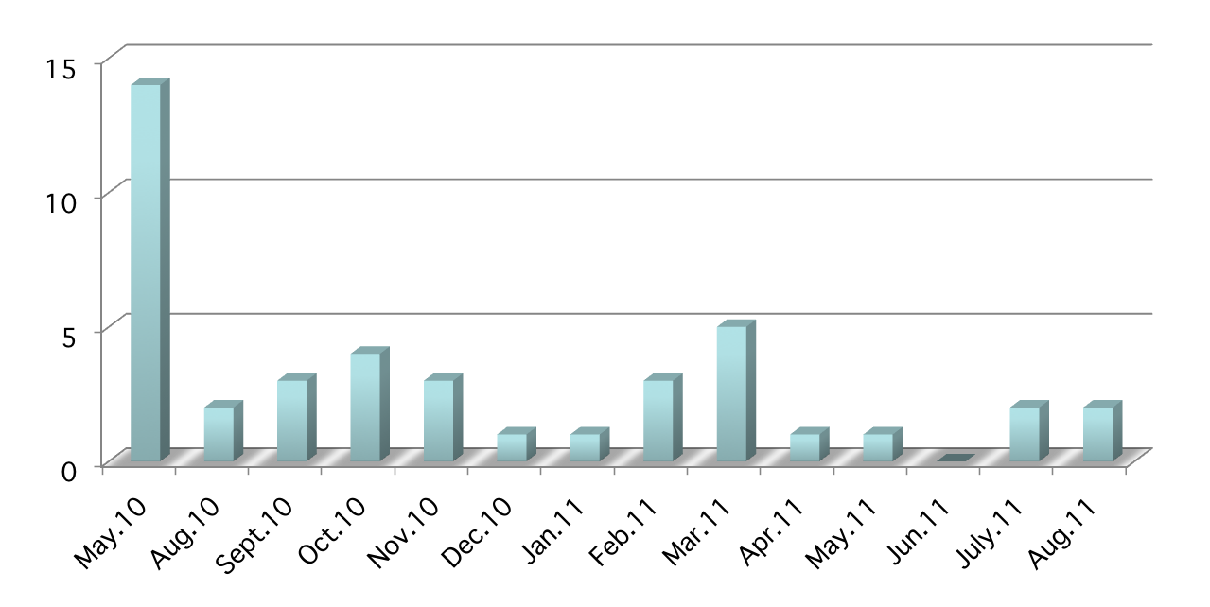
Trips to CSD
*
*The regular CSD inventory person is on leave for an extended amount of time.
New inventory person is being familiarized with our supplies.
Notes:
Use this to mention how SIGNIFICANTLY your visits to inventory went down

Slide 20
Our Challenges
Working with CSD was a wonderful experience. They were very helpful with their expertise. At the time though, they were starting a new scanning system and it took about 1.5 months to set up.
Getting to know where everything was—items have changed locations and a new OR supply cart was implemented—we remedied this with a scavenger hunt.
Learning to live with less and changing our tendency to hoard since we had learned in the past that it was easier to stash things because our old stocking system didn’t meet our needs.
Notes:
Use this to point out changed behavior: HOARDING

Slide 21
Our Successes
Better workflow
Less frustration of staff (we were working smarter, not harder)
Returned over $6,000 dollars worth of overstock supplies
By consolidating sutures, we brought our PAR level down from $7,396.20 to $4,303.04 (the difference of $3,093.16)
Decreased overall PAR level from $29,389 to $20,897
Notes:
Use this slide to point out money SAVED

Slide 22
Our Key Learnings
This was one of the first projects that we had to closely collaborate with another department. By working toward a common goal, we established new friendships and a deeper appreciation of one another’s expertise.
This was one of our first projects, so it helped us to move along as a team and change our thinking to problem solving. Because of it’s success, it empowered most of the staff that ‘YES, we are able to make positive changes!’
Notes:
Closing remarks if you have time

Slide 23
Santa Rosa Emergency Dept.
Virtual UBT Fair -- May 23, 2012
Notes:
Note to teams:
Font: Times New Roman, 20 to 28 point
Use any or all of the slides
Load presentation onto your laptop
Show on automatic loop or go through presentation manually with a specific audience

Slide 24
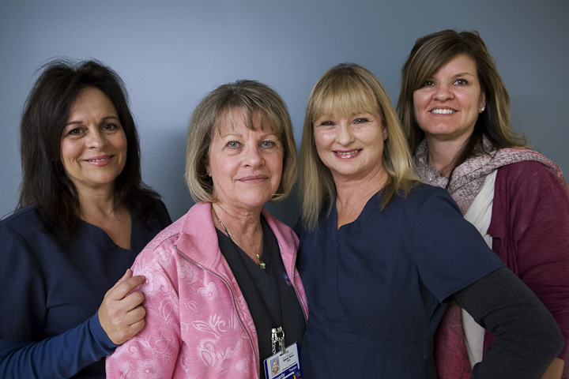
Our Team
Name
Shirley Minnehan, Co-Lead | Patrice Howell, Co-Lead
Kim Maffia | Anne Frieseke
Jackie Olea | Scott McAdams
Beverly Theilen | Georgette Effisimo
Bertie Jerro | Cathy Brazil
Ashley Angel | Astrid Stevenson
Jessie Nagra | Mary Agbayani
Suzanne Allen | Barbara Seubert
Notes:
Name all team members or representative team members
Designate co-leads
To add names, right click anywhere in table, select insert row below

Slide 25
The Problem
Four years ago, the Emergency department was in the middle of the pack for cost-share collection in the Northern California region.
The team decided it wanted to do better.
Notes:
A SMART goal is Specific, Measureable, Attainable, Realistic, Time-bound.
Specific: Be clear about what you want to improve.
Define your scope of work.
Measureable: How will you track improvements? If you
don’t have baseline numbers, that first thing you need
to do is establish them. Be sure to record your baseline
and target numbers.
Attainable: What is your current performance? Do you
really think you can attain the goal in the time frame
stated? Be ambitious, but make the goal achievable.
Realistic/Relevant: Is this something the team can directly
affect? Does it have a bearing on the main work of the
department?
Time-bound: Be sure to include when the improvement
will be made by.

Slide 26
Our Tests of Change
Ran weekly cost-share reports that listed each staff member’s NUID and how much he or she collected in co-pays.
Manager and chief sent emails to staff members recognizing a job well done, encouraging those who had less-than-stellar co-pay collection, and seeking feedback on any obstacles hindering co-pay collection.

Slide 27
Our Tests of Change
Team members visited other high-performing Emergency departments in the region.
Developed a script with various scenarios for Santa Rosa Patient Services Representatives to use.
Educated nurses and physicians about the importance of co-pay collection and their role in helping service representatives collect co-pays.

Slide 28
Our Challenges
Discomfort about asking members/patients for money.
Convincing nurses and physicians that co-pay collection is also their concern.
Educating patients/members, who were used to being billed later or for whom payment was the last thing on their mind.

Slide 29
Our Successes
Santa Rosa Emergency Department is now #1 for co-pay collection among EDs in Northern California.
We have held that position for two years in a row!

Slide 30
Our Key Learnings
To be successful, involve the entire department.
Communicate the goal clearly and often.
Provide feedback and review individual cost share stats once a week.
Creating friendly competition is a good motivator.
Celebrating successes builds motivation and more success.
As you start to see success, let other facilities know that you’re in the game and plan on reaching #1...Believing you will get there is 3/4 of the battle!

